Slide 1

Fundamentals of Chemistry
CHEM 101
Date: 14/06/2022
Tamanna Ishrat Farhana, PhD
Assistant Professor
Dep of Sci. and Hum.
MIST, Mirpur Cantonment, Dhaka

Slide 2

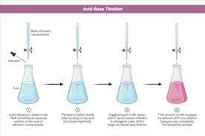
Acid-base titration
An acid–base titration is a method of quantitative analysis for determining the concentration of an acid or base by exactly neutralizing it with a standard solution of base or acid having known concentration.
In an acid-base titration the base solution can be added gradually from a burette into an acid solution contained in a receiver flask
When the amount of the base added equals the amount of the acid in the flask, the equivalence point or the end-point is reached.
The end-point of a titration is shown by colour change of an indicator previously added to the acid solution in the receiver flask

Slide 3
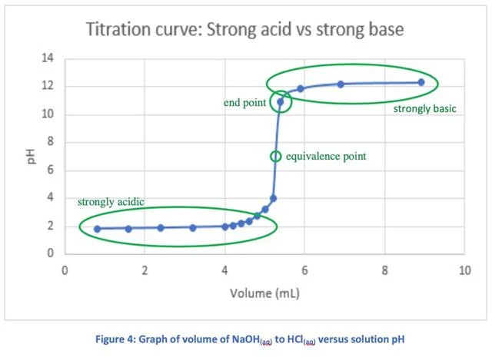

Slide 4
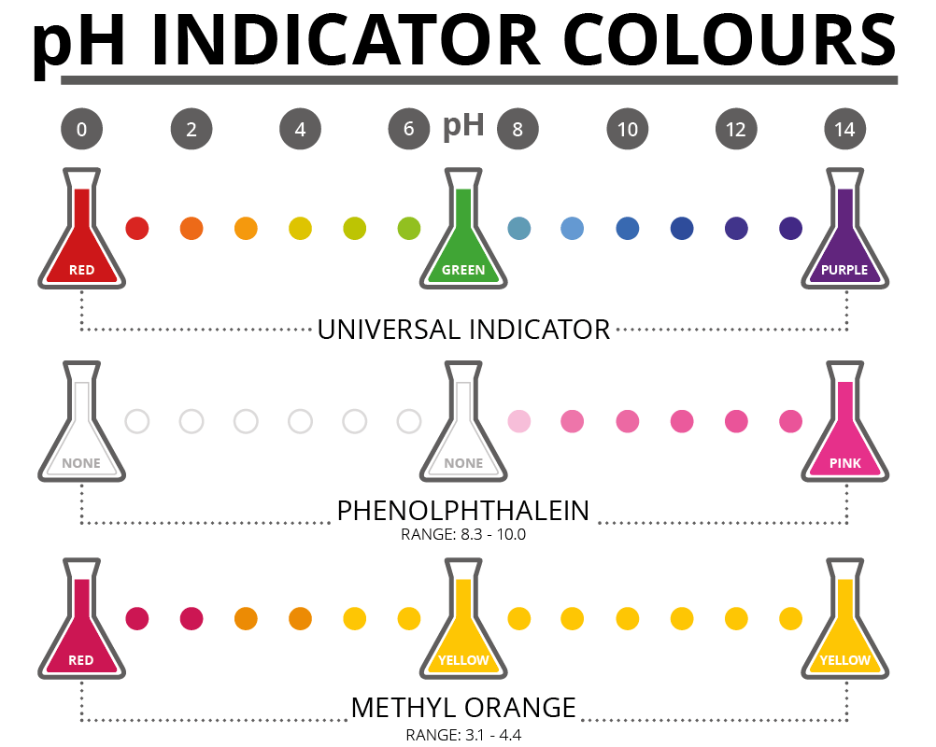
Acid-base indicator/pH indicator
An acid-base indicator is an organic dye that signals the end-point by a visual change in color.
Phenolphthalein and methyl orange are two common examples of acid-base indicators. Phenolphthalein is pink in base solution and colorless in acid solution

Slide 5
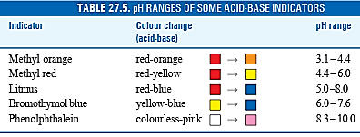
Indicators pH range

Slide 6
pH Curve
Titration curves show how the pH of the solution changes as a known chemical is added to the solution, so any point along the curve gives you information on solution pH as the volume of the known chemical increases

Slide 7
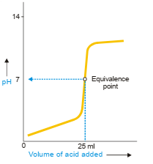
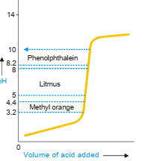
pH Curve
Titration curves show how the pH of the solution changes as a known chemical is added to the solution, so any point along the curve gives you information on solution pH as the volume of the known chemical increases
Base

Slide 8
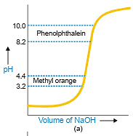
pH Curve and suitable indictors
(a) Strong acid and strong base
The vertical portion of the curve extends from pH 3 to pH 7. The pH ranges of methyl orange (3.1– 4.4), and phenolphthalein (8.30 – 10.0) are fairly narrow and fall on the vertical curve.
Thus both methyl orange and phenolphthalein are suitable indicators for strong acid/strong base titrations. Litmus with an exceptionally wide pH range (4.5 – 8.3) is seldom used.

Slide 9
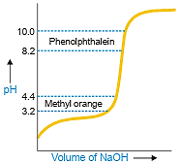
pH Curve and suitable indictors
(a)Weak acid and strong base
Phenolphthalein is a suitable indicator, while methyl orange is not.

Slide 10
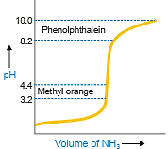
pH Curve and suitable indictors
(a)Strong acid and weak base
methyl orange and methyl red are suitable indicators for strong acid/weak base titrations.

Slide 11
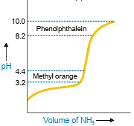
pH Curve and suitable indictors
(a) Weak acid and weak base

Slide 12
THEORIES OF ACID-BASE INDICATORS
An acid-base indicator is an organic substance used for the detection of equivalence point or neutral point in an acid-base titration. An indicator has one colour in acid solution and entirely different in basic solution. The end-point of the titration is shown by a colour change of the indicator.
Two theories have been put forward to explain the indicator action in acid-base titrations :
(1) The Ostwald’s theory
(2) The Quinonoid theory

Slide 13


The Ostwald’s theory
Let us explain the indicator action by taking example of methyl orange. Methyl orange is a weak acid and gives the following ionisation equilibrium in solution
In accordance with the law of mass action,
where K in is the dissociation constant of the indicator and is called the Indicator constant.
The anion In– is yellow and the nonionised form H_{In}– is red. If an acid is added to the solution, the hydrogen ion concentration, [H+], in the equilibrium expression (1) increases. To maintain Kin constant, the equilibrium shifts to the left. Thereby the concentration of [In–] is reduced and the concentration of [HIn] increases so that the solution is red.

Slide 14
On the other hand, upon addition of a base to the solution, H+ ions are removed as H₂O by reacting with OH– ions of the base. This shifts the equilibrium to the right, resulting in the increase of In– ions that are yellow.
Thus in acid solution the unionised HIn molecules predominate and the solution is pink, while in basic solution In– ions are in excess and the solution is yellow.

Slide 15

Relation of Indicator colour to pH
The actual colour shade of the indicator depends on the ratio of concentration of In– and HIn present in solution. From the equilibrium constant expression (1) we can write
If [H+] is large, the concentration of In– ions is also large and the colour is yellow. When [H+] is small, [HIn] is large and the solution is red. At the equivalence point, [In] = [HIn] and the colour is orange (red + yellow). Obviously the indicator colour is controlled by hydrogen ion concentration or pH of the solution.

Slide 16
The numerical value of the indicator constant K_{in} for methyl orange is 3.6 and the pH of the orange solution is, therefore, about 4. As the values of Kin for the various indicators are different, they will have intermediate intense colours (middle tint) at different pH values. When a base is added to an acid solution in a titration, the colour change of the indicator is gradual. It just becomes visible to the human eye when [In ]/[HIn] 1/10 = and pH calculated from equation (3) is 3.1. The colour of the indicator continues to change till [In–] / [HIn] = 10 when pH is 4.4. The pH range between 3.1 (red) and 4.4 (yellow) is called the colour change interval of methyl orange. The visible indicator colour change takes place between these pH values.

Slide 17
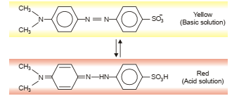
Methyl Orange
The red quinonoid form of methyl orange exists in acid solution. It is converted to yellow benzenoid form when pH alters to the basic side.

Slide 18
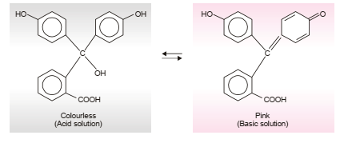
Phenolphthalein structure and mechanism
Phenolphthalein exists in two tautomeric forms : (i) the benzenoid form which is yellow and present in basic solution; and (ii) the quinonoid form which is pink and present in acid solution.

Slide 19
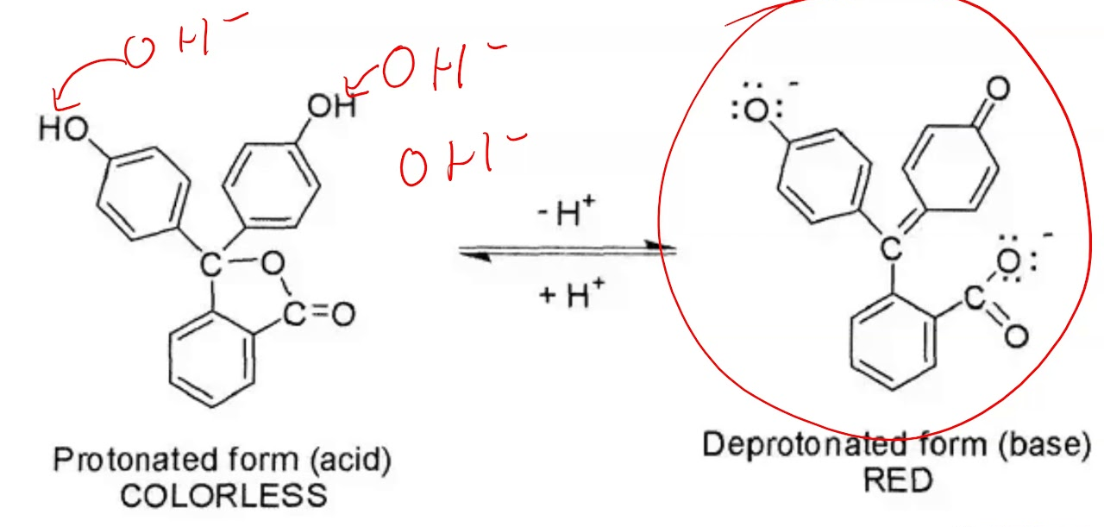

Slide 20
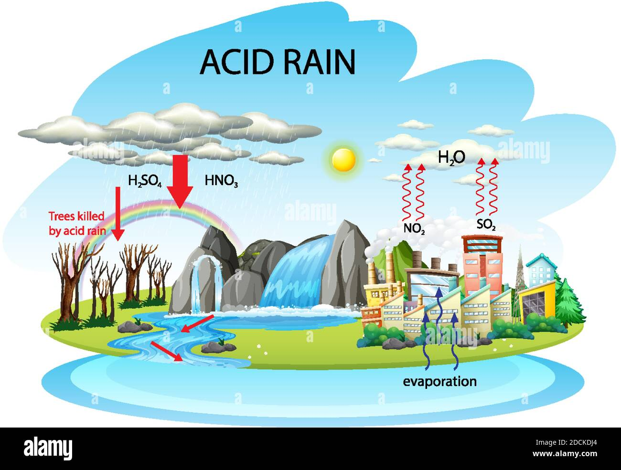
Acid rain

